Slide 1
FINAL REPORT Simulating action potentials in cardiac cells in order to determine the link between atrial fibrillation and ectopic foci in the pulmonary vein
Girish Gupta and Lucy Foster

Slide 2
Introduction
Heart disease big killer in the Western world.
Atrial fibrillation most common form of cardiac arrhythmia.
It involves the heart not beating effectively, one cause of which is believed to be an ectopic heart beat coming from the pulmonary vein.
Blood can pool then clot.
Clots getting lodged in the brain can lead to a stroke.
The aim of this project: to produce a computer model to simulate conditions believed to lead to this.

Slide 3
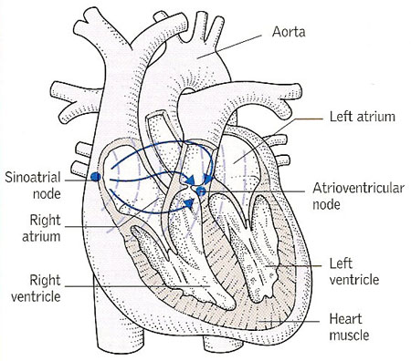
The heart
Pulmonary vein carries oxygenated blood back to the heart from the lungs.
Heart beat: a contraction with an electro-physical basis.
Starts as an action potential in a pace making cell, causing a wave of contraction to pass through the heart.
SA node natural pace-making cell of the heart.
Darling, D. <http://www.daviddarling.info/encyclopedia/S/sinoatrial_node.html>. (Image used with permission.)

Slide 4
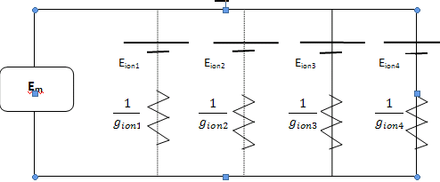
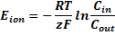
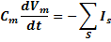
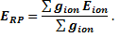
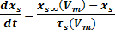
Modelling cardiac cells
Ion channel modelling:
Ion channels are gated
Voltage stimuli open and close gates.
Mathematical model to show channel activation, based upon activation variable r, it depends on whether the m and h gates are open or closed.
Hodgkin Huxley models:
Nernst potential of the ion. (equilibrium potential)
Resting potential of the membrane
Current flows because of stimulus altering membrane potential.

Slide 5
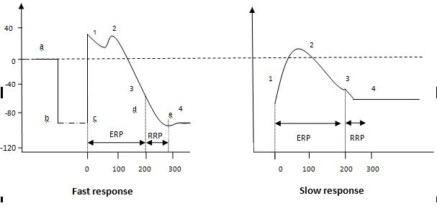
An action potential
Berne, R.M, Levy, M.N. 2000, Principles of Physiology, Modsby, Missouri.
Slow response are that off pace-making cells.
Slope of depolarisation much steeper in fast response.
Slow response initial resting potential less negative.
Overshoot of slow response less than that of fast response.

Slide 6
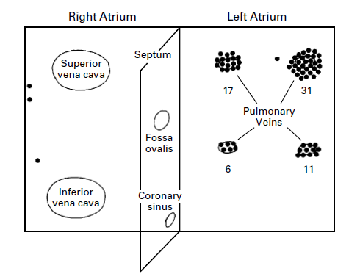
Evidence of pulmonary vein link
Atrial fibrillation comes from natural pace-making cell being overwhelmed by disorganized electrical impulses coming from elsewhere.
Atrial fibrillation: multiple activation waves within the atria.
A lot of evidence that shows not only the PV has pacemaking cells but also that this is linked to atrial fibrillation for example Haissaguerre et al and Perez Lugones et al.
Haissaguerre, M et. al. 1998, ‘Spontaneous initiation of atrial fibrillation by ectopic beats originating in the pulmonary veins, New England Journ. of Med., vol. 339, no. 10, pp. 659-666.

Slide 7
Methodology: computer methods
Code in C
Early stages worked on single cell models which ran on PC
Full 3D model needed more CPU
3D geometry file with single cell header files indexed into a 3D array
Horace
32 CPU
Code is run in small steps (HT)

Slide 8
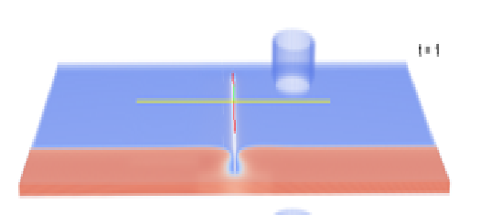
Self-oscillation
if((y>=325 && y<= 350) && (x>=25 && x<=275))
for (x=100; x<=200; x++)
for (y=325; y<=350; y++)
for (z=0; z<=10; z++)
if (h[x][y][z] > 0) {
V[x][y][z] = 20.0;
new_V[x][y][z] = 20.0;
}
// ** Begin voltage calculation ** //
while (t < 50.0) {
t+=HT;
cnt++;
if (t>=0.89 && t<(0.89+HT))
{
for (x=100; x<=200; x++)
for (y=325; y<=350; y++)
for (z=0; z<=10; z++)
if (h[x][y][z] > 0) {
V[x][y][z] = 20.0;
new_V[x][y][z] = 20.0;
}
}
Small cube geometry to try and get self oscillations using less processing, running for longer.
Tested different versions of the code.
Minor adjustments as not to get too far from original.
Back to single cell code.
Assured single cell self oscillated re-indexed this.
Got self oscillations.
One stimulus at start, later repolarisation of AP in PV.
Notes:
Interim report we had not yet seen, vital o our experiment, needed to see that the PV was capable of sustaining self oscillations, ie capable of producing an ectopic beat.

Slide 9
Spiral waves
Earlier simulations used resting points in code to produce spirals
Take these out
Time a new excitation to interact with self oscillation to get a spiral wave.
Once this was verified could use ‘artificial’ spiral again to look at pinning.
if (t>=0.04 && t<(0.04+HT))
for (x = BLOCK_LOW(rank, size, X+1); x <= BLOCK_HIGH(rank, size, X+1); x++)
{
for (y=0; y<=200; y++)
for (z=0; z<=10; z++)
{
V[x][y][z] = -73.8;
new_V[x][y][z] = -73.8;
}
for (y=400; y<=Y; y++)
for (z=0; z<=10; z++)
{
V[x][y][z] = -73.8;
new_V[x][y][z] = -73.8;
}
}

Slide 10
Heart Beat
More realistic conditions.
Make the initial beat repeat itself.
Difficult to get timing right.
Too quickly would simply wipe out.
Started by simply getting two coming in one after the other eventually extended to a repeating stimuli every 400 ms – effectively a real heart beat.
if (t>=(girishcounter*0.1) && t<((girishcounter*0.1)+HT))
{
for (x=100; x<=200; x++)
for (y=325; y<=350; y++)
for (z=0; z<=10; z++)
if (h[x][y][z] > 0) {
V[x][y][z] = 20.0;
new_V[x][y][z] = 20.0;
}
girishcounter++;
}

Slide 11
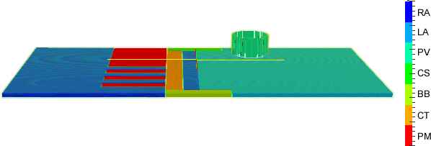
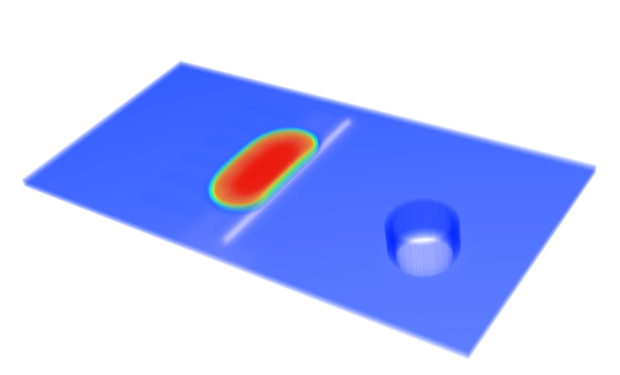
New geometry

Slide 12
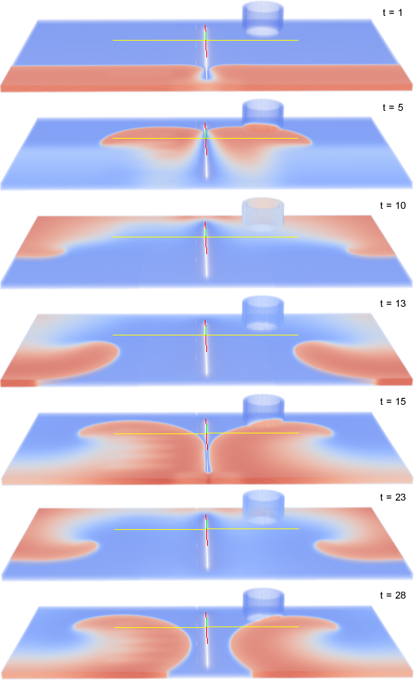
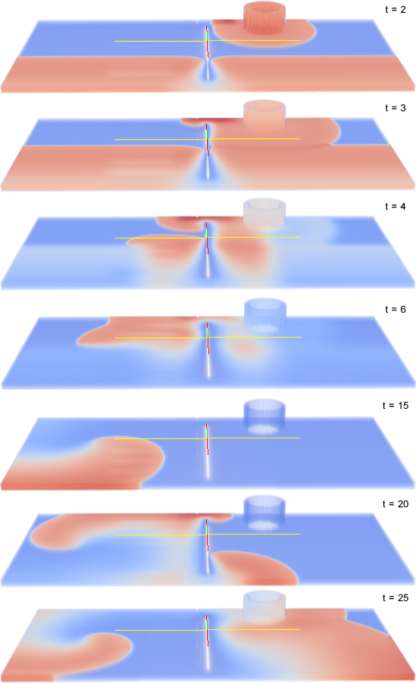

Slide 13
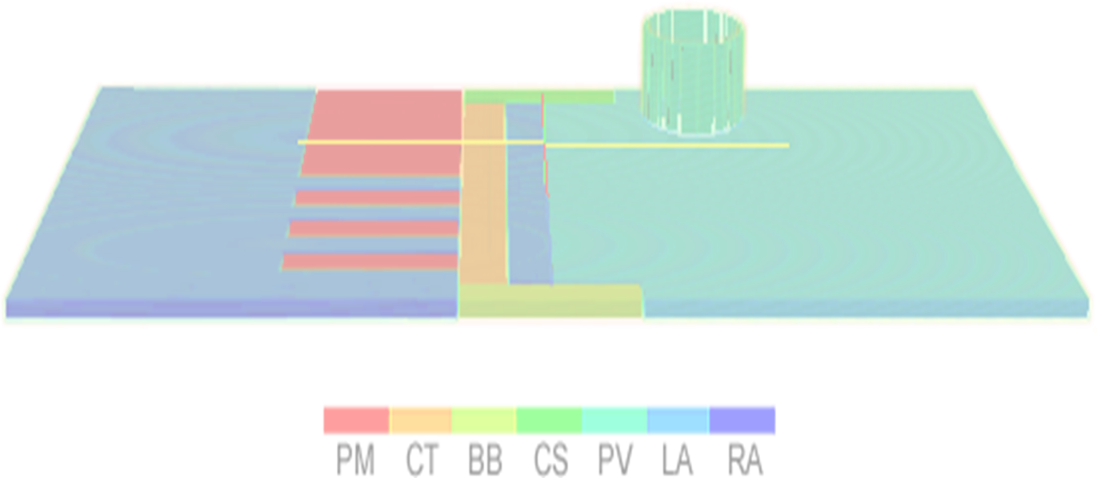
JANUARY: What next?
Refine the geometry file to become more anatomically accurate.
Stimulate the anatomically correct points.
Self-excitation in the pulmonary vein itself.
This and further work will establish the link between ectopic foci in the pulmonary vein and atrial fibrillation, as per our aim.

Slide 14
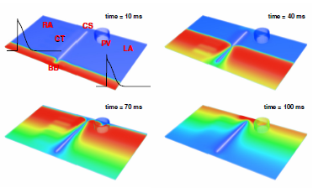
Initiation and propagation of action potentials through the atria towards the pulmonary vein.

Slide 15
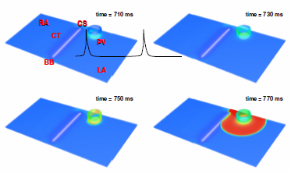
Initiation and propagation of an ectopic action potential from the pulmonary vein. This is the self-oscillation.

Slide 16
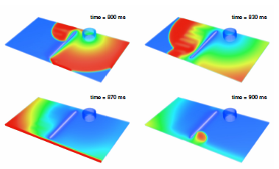
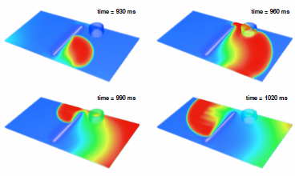
Interaction of the ectopic stimulation from previous figure and the initial stimulus from the one before to give a spiral wave.

Slide 17
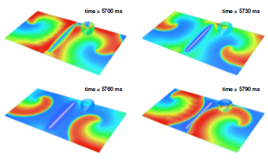
Our research has not found evidence that the spiral wave is pinned to the pulmonary vein.

Slide 18
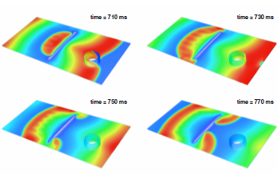
Fast, periodic pacing, suppresses ectopic foci in the pulmonary vein.

Slide 19
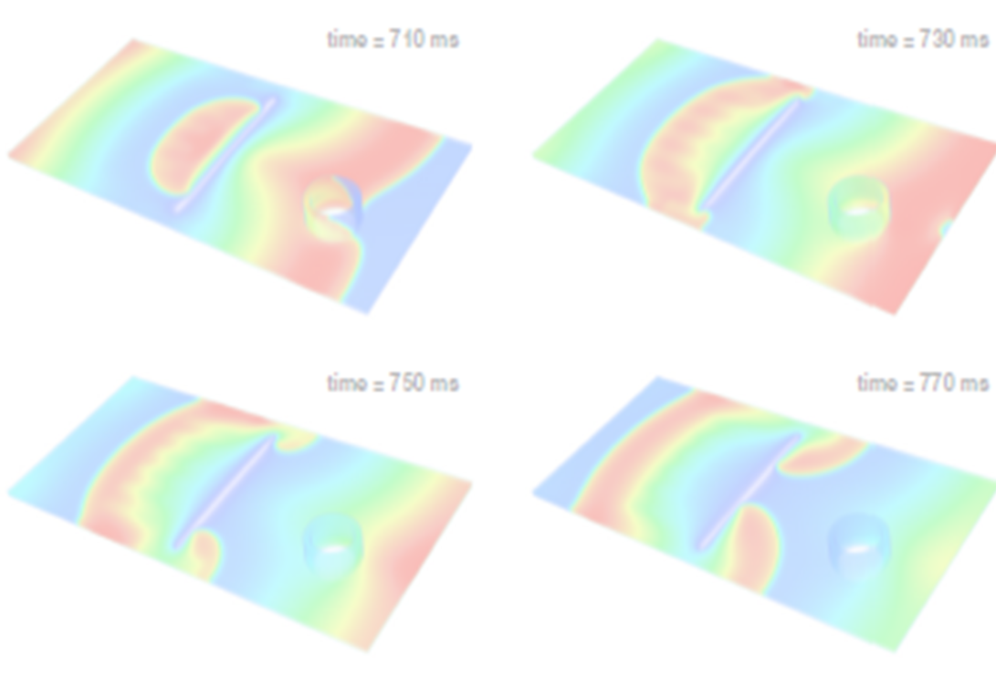
Conclusions and Further Work
Need to confirm formation of spiral waves with new stimulus site.
Need to look carefully at pinning and attempt to demonstrate it, if it is the case.
Investigate the link between atrial fibrillation and stroke.

Slide 20
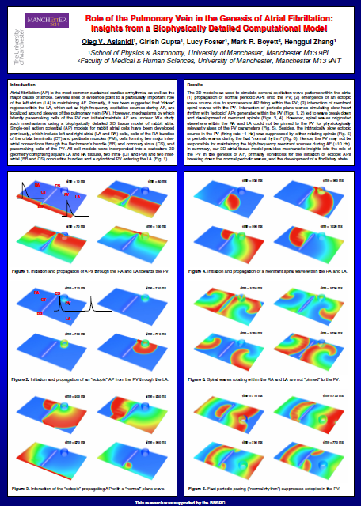
Our work was presented at a meeting of the Northern Cardiovascular Research Group on 22nd March 2010.
It has also been submitted to and accepted elsewhere.

